Slide 1


Mantravadi Keerthi
1st April 2023

Slide 2

Outline
Executive Summary
Introduction
Methodology
Results
Conclusion
Appendix

Slide 3
Executive Summary
Summary of methodologies
SpaceX Data Collection using SpaceX API
SpaceX Data Collection with Web Scraping
SpaceX Data Wrangling
SpaceX Exploratory Data Analysis using SQL
Space-X EDA DataViz Using Python Pandas and Matplotlib
Space-X Launch Sites Analysis with Folium
Interactive Visual Analytics and Ploty Dash
SpaceX Machine Learning Landing Prediction
Summary of all results
EDA results
Interactive Visual Analytics and Dashboards
Predictive Analysis(Classification)

Slide 4
Introduction
Project background and context
SpaceX advertises Falcon 9 rocket launches on its website with a cost of 62 million dollars; other providers cost upward of 165 million dollars each, much of the savings is because SpaceX can reuse the first stage.
Therefore, we can calculate the price of a launch if we can predict whether the first stage will land. If another business wishes to compete with SpaceX for a rocket launch, it can use this information.
Problems you want to find answers
Using information from Falcon 9 rocket launches that were publicized on the company website, we will forecast whether the Falcon 9 first stage will safely land in this capstone.

Slide 5

Section 1

Slide 6
Methodology
Executive Summary
Data collection methodology:
Describe how data was collected
Perform data wrangling
Describe how data was processed
Perform exploratory data analysis (EDA) using visualization and SQL
Perform interactive visual analytics using Folium and Plotly Dash
Perform predictive analysis using classification models
How to build, tune, evaluate classification models

Slide 7
Data Collection
Description of how data sets were collected.
Data was initially gathered by sending a get call to the SpaceX API, a RESTful API, using the SpaceX API. In order to accomplish this, a series of helper functions that would aid in the use of the API to extract information using identification codes in the launch data were first defined. Following that, the SpaceX API URL was requested to obtain rocket launch data.
The SpaceX launch data was finally cleaned up to improve the consistency of the requested JSON output. the answer content was GET-requested, parsed, and then decoded as a JSON result before being converted into a Pandas data frame.
Moreover, web scraping was done to get past Falcon 9 launch data from a Wikipedia page named-(List of Falcon 9 and Falcon Heavy launches – Wikipedia) where the data is saved in HTML. I extract the Falcon 9 launch HTML table using BeautifulSoup and request Library,the Wikipedia page's records, Parsed the table and created a Pandas data frame from it.

Slide 8
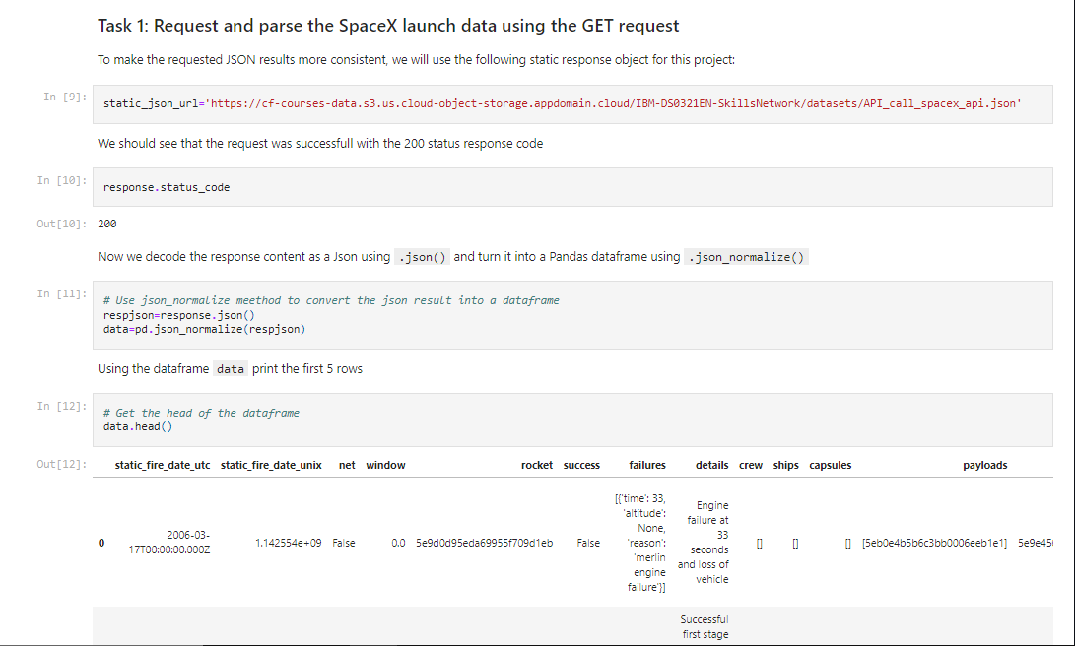
Data Collection – SpaceX API
Data collected using SpaceX API (a RESTful API) by making a get request to the SpaceX API then requested and parsed the SpaceX launch data using the GET request and decoded the response content as a Json result which was then converted into a Pandas data frame
The GitHub URL of the completed SpaceX API calls notebook-
https://github.com/MantravadiKeerthi/-SpaceX-Falcon-9-1st-stage-Success-Landing-Prediction/blob/main/1.Data%20Collection%20API.ipynb

Slide 9
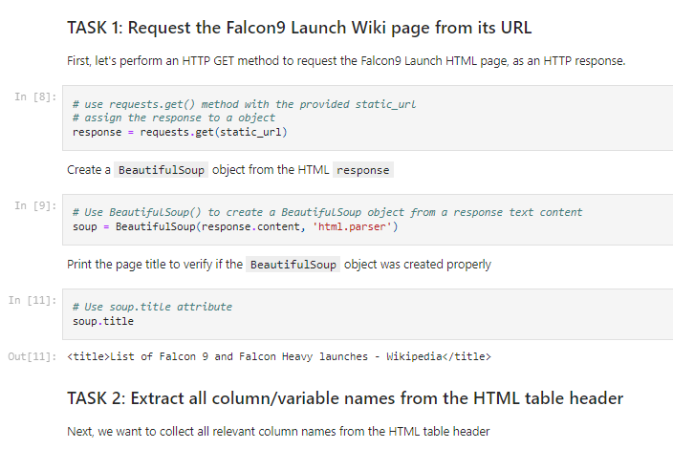
Data Collection - Scraping
Performed web scraping to collect Falcon 9 historical launch records from a Wikipedia using BeautifulSoup and request, to extract the Falcon 9 launch records from HTML table of the Wikipedia page, then created a data frame by parsing the launch HTML.
The GitHub URL of the completed web scraping notebook-
https://github.com/MantravadiKeerthi/-SpaceX-Falcon-9-1st-stage-Success-Landing-Prediction/blob/main/2.Data%20Collection%20with%20Web%20Scraping.ipynb

Slide 10
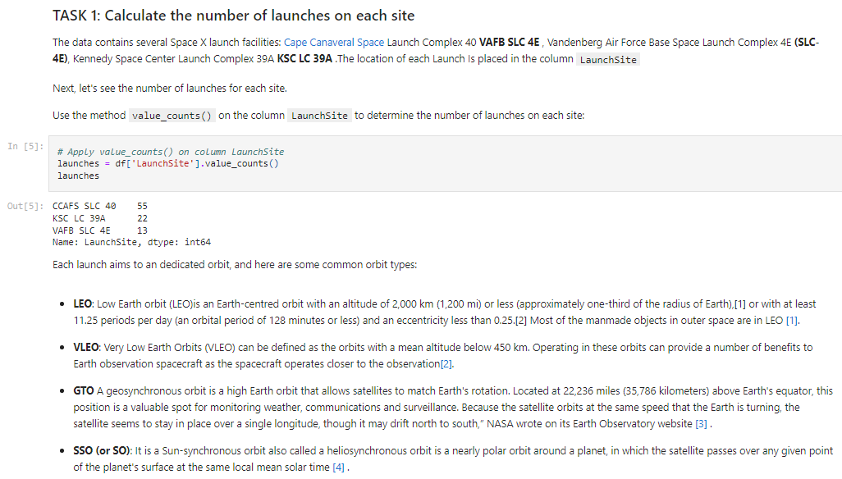
Data Wrangling
After obtaining and creating a Pandas DF from the collected data, data was filtered using the BoosterVersion column to only keep the Falcon 9 launches, then dealt with the missing data values in the LandingPad and PayloadMass columns. For the PayloadMass , missing data values were replaced using mean value of column.
Also performed some Exploratory Data Analysis (EDA) to find some patterns in the data and determine what would be the label for training supervised models
The GitHub URL of the completed data wrangling related notebooks-
https://github.com/MantravadiKeerthi/-SpaceX-Falcon-9-1st-stage-Success-Landing-Prediction/blob/main/3.Data%20wrangling.ipynb

Slide 11
EDA with Data Visualization
• Performed data Analysis and Feature Engineering using Pandas and Matplotlib.i.e.
Exploratory Data Analysis
Preparing Data Feature Engineering
• Used scatter plots to Visualize the relationship between Flight Number and Launch Site, Payload and Launch Site, Flight Number and Orbit type, Payload and Orbit type.
• Used Bar chart to Visualize the relationship between success rate of each orbit type
• Line plot to Visualize the launch success yearly trend
The GitHub URL of the completed EDA with data visualization notebook-
https://github.com/MantravadiKeerthi/-SpaceX-Falcon-9-1st-stage-Success-Landing-Prediction/blob/main/5.EDA%20with%20Visualization.ipynb

Slide 12
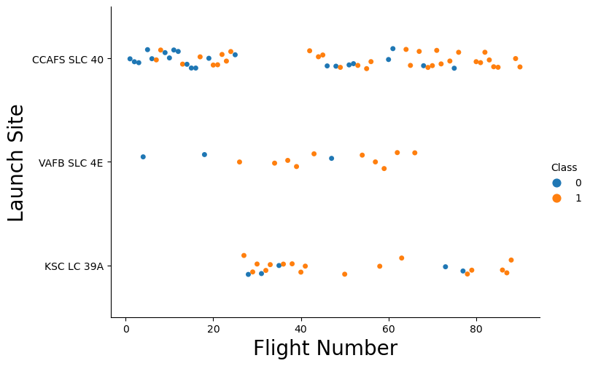
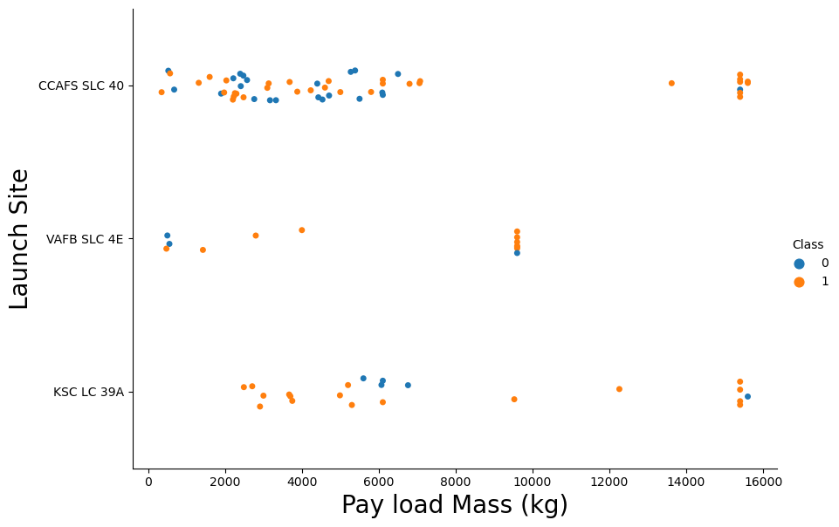
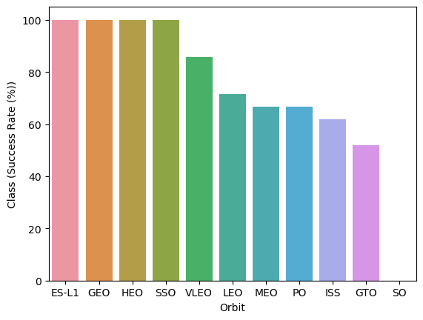
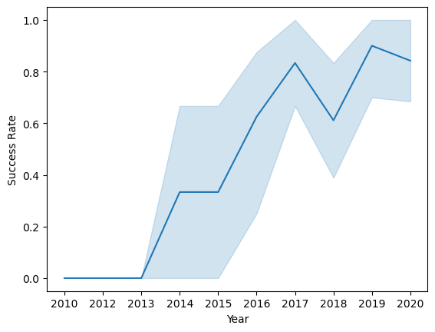
EDA with Data Visualization (Plots Cont….)

Slide 13
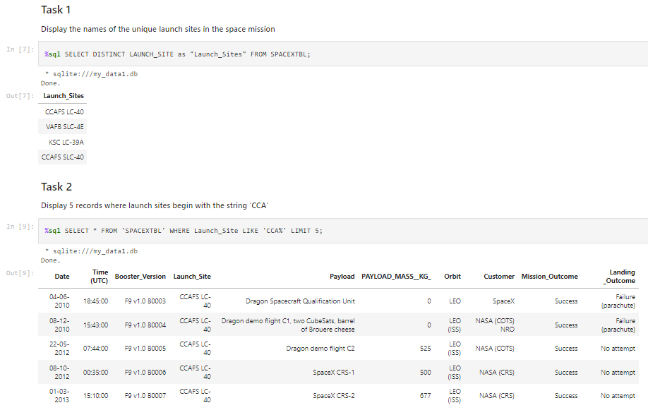
EDA with SQL
The following SQL queries were performed for EDA
Display the names of the unique launch sites in the space mission
Display 5 records where launch sites begin with the string 'CCA‘
Display the total payload mass carried by boosters launched by NASA (CRS)
Display average payload mass carried by booster version F9 v1.1
List the date when the first successful landing outcome in ground pad was achieved

Slide 14
EDA with SQL (Cont.…)
List the names of the boosters which have success in drone ship and have payload mass greater than 4000 but less than 6000 (%sql SELECT DISTINCT Booster_Version, Payload FROM SPACEXTBL WHERE "Landing _Outcome" = "Success (drone ship)" AND PAYLOAD_MASS__KG_ > 4000 AND PAYLOAD_MASS__KG_ < 6000;)
List the total number of successful and failure mission outcome
The GitHub URL of the completed EDA with SQL notebook-
https://github.com/MantravadiKeerthi/-SpaceX-Falcon-9-1st-stage-Success-Landing-Prediction/blob/main/4.EDA%20Using%20SQL.ipynb

Slide 15
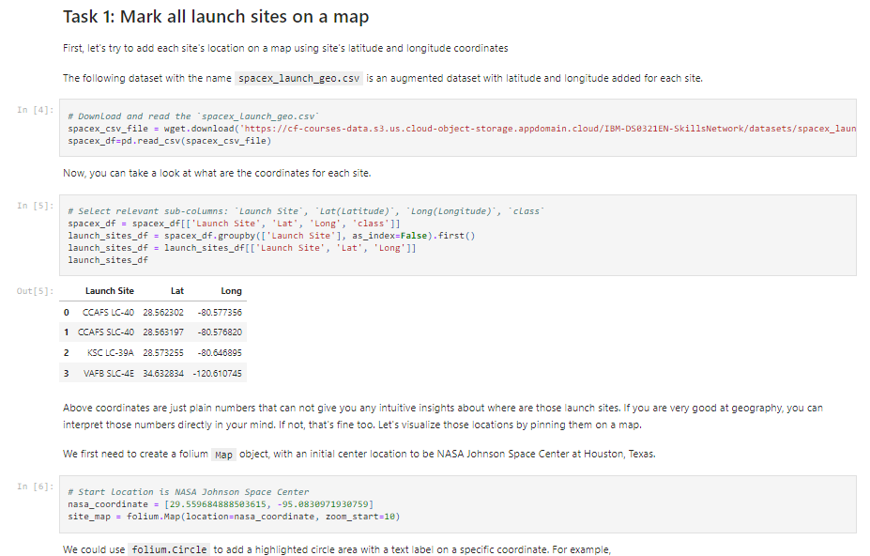
Build an Interactive Map with Folium
Created folium map to marked all the launch sites, and created map objects such as markers, circles, lines to mark the success or failure of launches for each launch site.
Created a launch set outcomes (failure=0 or success=1).
The GitHub URL of the completed interactive map with Folium map-
https://github.com/MantravadiKeerthi/-SpaceX-Falcon-9-1st-stage-Success-Landing-Prediction/blob/main/6.Interactive%20Visual%20Analytics%20with%20Folium.ipynb

Slide 16
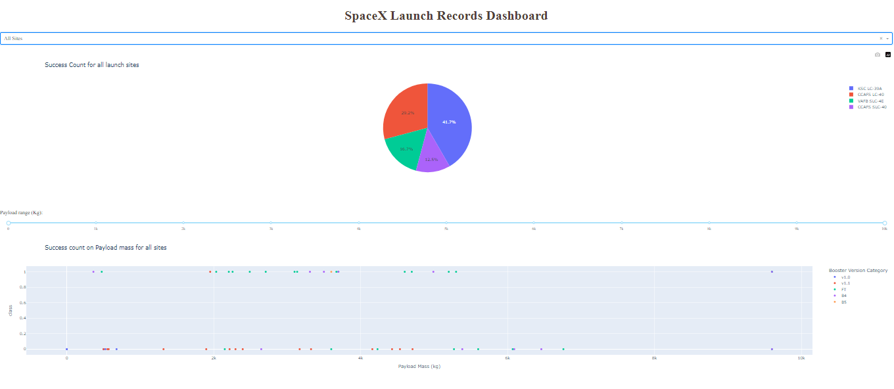
Build a Dashboard with Plotly Dash
Built an interactive dashboard application with Plotly dash by:
Adding a Launch Site Drop-down Input Component
Adding a callback function to render success-pie-chart based on selected site dropdown
Adding a Range Slider to Select Payload
Adding a callback function to render the success-payload-scatter-chart scatter plot
The GitHub URL of the completed Plotly Dash lab-https://github.com/MantravadiKeerthi/-SpaceX-Falcon-9-1st-stage-Success-Landing-Prediction/blob/main/7.%20Build%20an%20Interactive%20Dashboard%20with%20Ploty%20Dash

Slide 17
Predictive Analysis [Classification]
Summary of how I built, evaluated, improved, and found the best performing classification model
After loading the data as a Pandas Dataframe, I set out to perform exploratory Data Analysis and determine Training Labels by;
Creating a NumPy array from the column Class in data, by applying the method to_numpy() then assigned it to the variable Y as the outcome variable.
Then standardized the feature dataset (x) by transforming it using preprocessing.StandardScaler() function from Sklearn.
After which the data was split into training and testing sets using the function train_test_split from sklearn.model_selection with the test_size parameter set to 0.2 and random_state to 2.

Slide 18
Predictive Analysis [Classification] (Cont.…)
In order to find the best ML model/ method that would performs best using the test data between SVM, Classification Trees, k nearest neighbors and Logistic Regression;
First created an object for each of the algorithms then created a GridSearchCV object and assigned them a set of parameters for each model. • For each of the models under evaluation, the GridsearchCV object was created with cv=10, then fit the training data into the GridSearch object for each to Find best Hyperparameter.
After fitting the training set, we output GridSearchCV object for each of the models, then displayed the best parameters using the data attribute best_params_ and the accuracy on the validation data using the data attribute best_score_.
Finally using the method score to calculate the accuracy on the test data for each model and plotted a confusion matrix for each using the test and predicted outcomes.

Slide 19
Predictive Analysis [Classification] (Cont.…)
The table below shows the test data accuracy score for each of the methods comparing them to show which performed best using the test data between SVM, Classification Trees, k nearest neighbors and Logistic Regression;
The GitHub URL of the completed predictive analysis lab-
https://github.com/MantravadiKeerthi/-SpaceX-Falcon-9-1st-stage-Success-Landing-Prediction/blob/main/8.Machine%20Learning%20Prediction.ipynb

Slide 20
Results
Exploratory data analysis results
Interactive analytics demo in screenshots
Predictive analysis results

Slide 21

Section 2

Slide 22
Flight Number vs. Launch Site
scatter plot of Flight Number vs. Launch Site

Slide 23

Payload vs. Launch Site
Scatter plot of Payload vs. Launch Site

Slide 24

Success Rate vs. Orbit Type
Bar chart for the success rate of each orbit type

Slide 25
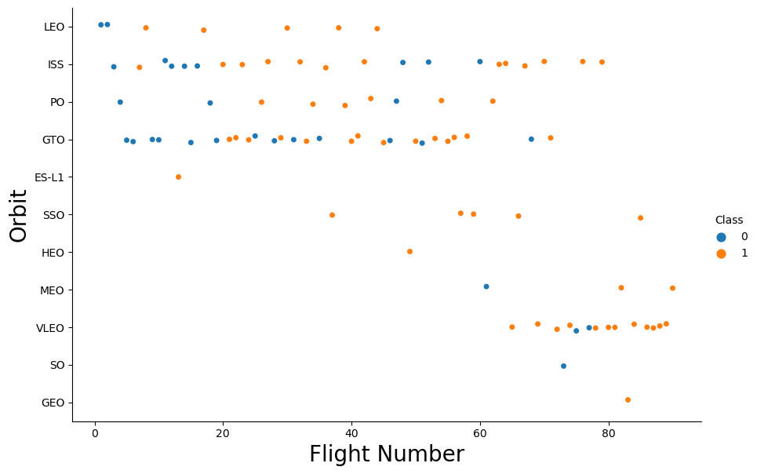
Flight Number vs. Orbit Type
Scatter point of Flight number vs. Orbit type

Slide 26
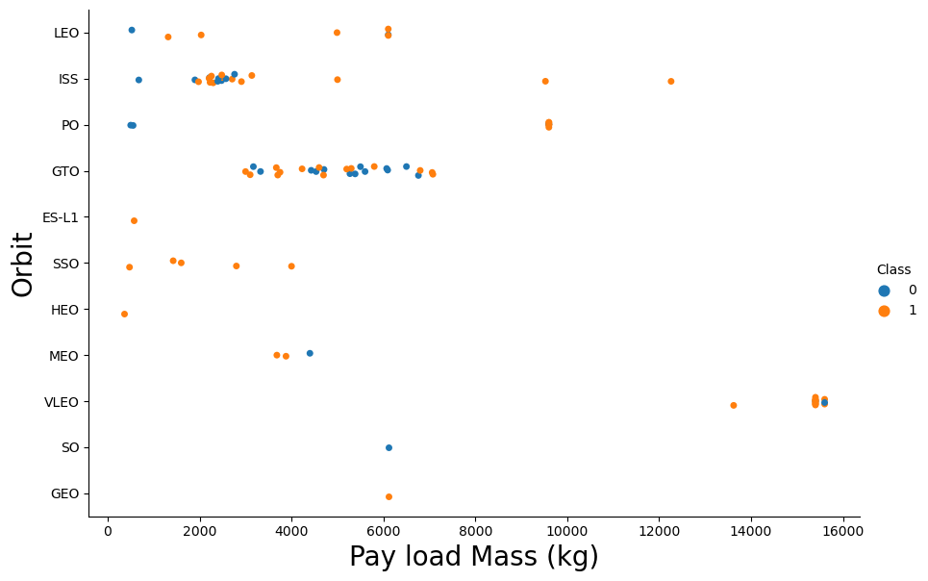
Payload vs. Orbit Type
Scatter point of payload vs. orbit type

Slide 27

Launch Success Yearly Trend
Line chart of yearly average success rate
Since 2013, the success rate kept going up till 2020

Slide 28
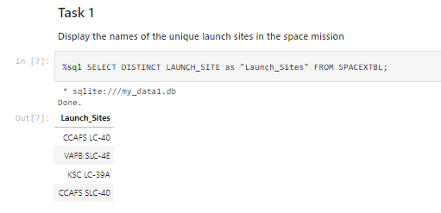
All Launch Site Names
Find the names of the unique launch sites
Used ‘SELECT DISTINCT’ statement to return only the unique launch sites from the ‘LAUNCH_SITE’ column of the SPACEXTBL table

Slide 29
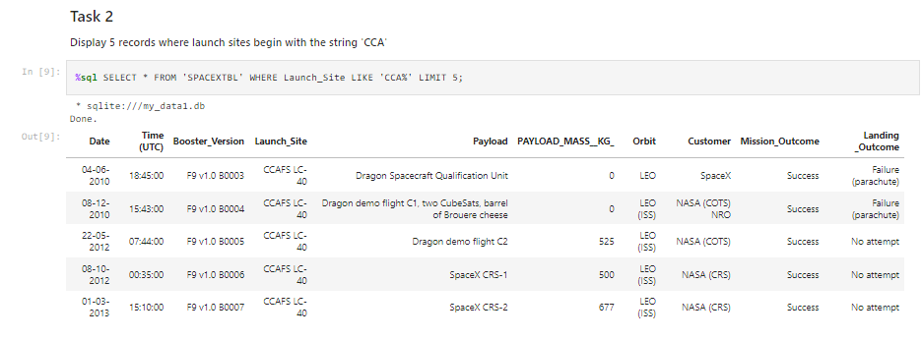
Launch Site Names Begin with 'CCA'
Find 5 records where launch sites begin with `CCA`
Used ‘LIKE’ command with ‘%’ wildcard in ‘WHERE’ clause to select and display a table of all records where launch sites begin with the string 'CCA'

Slide 30
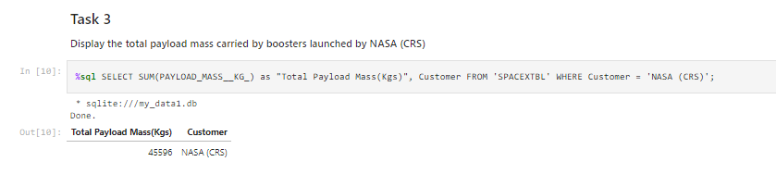
Total Payload Mass
Calculate the total payload carried by boosters from NASA
Used the ‘SUM()’ function to return and display the total sum of ‘PAYLOAD_MASS_KG’ column for Customer ‘NASA(CRS)’

Slide 31
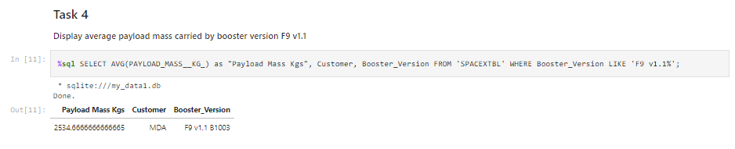
Average Payload Mass by F9 v1.1
Calculate the average payload mass carried by booster version F9 v1.1
Used the ‘AVG()’ function to return and display the average payload mass carried by booster version F9 v1.1

Slide 32
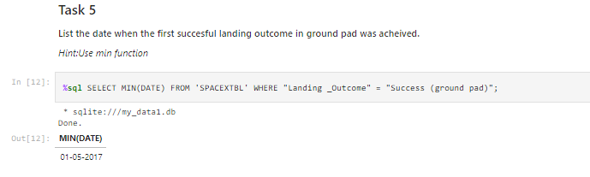
First Successful Ground Landing Date
Find the dates of the first successful landing outcome on ground pad
Used the ‘MIN()’ function to return and display the first (oldest) date when first successful landing outcome on ground pad ‘Success (ground pad)’happened.

Slide 33
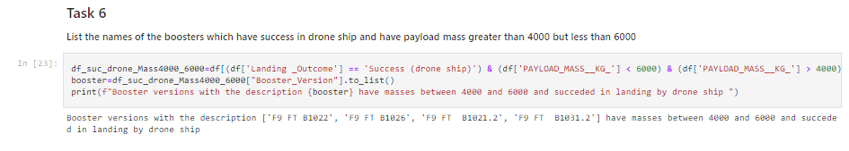
Successful Drone Ship Landing with Payload between 4000 and 6000
List the names of boosters which have successfully landed on drone ship and had payload mass greater than 4000 but less than 6000
Used ‘Select Distinct’ statement to return and list the ‘unique’ names of boosters with operators >4000 and <6000 to only list booster with payloads between 4000-6000 with landing outcome of ‘Success (drone ship)’

Slide 34
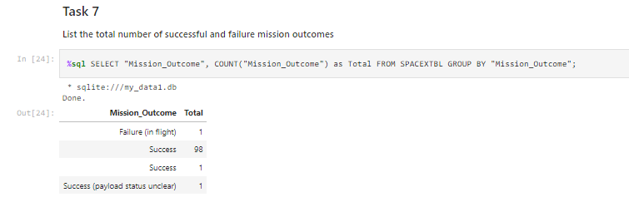
Total Number of Successful and Failure Mission Outcomes
Calculate the total number of successful and failure mission outcomes
Used the ‘COUNT()’ together with the ‘GROUP BY’ statement to return total number of missions outcomes

Slide 35
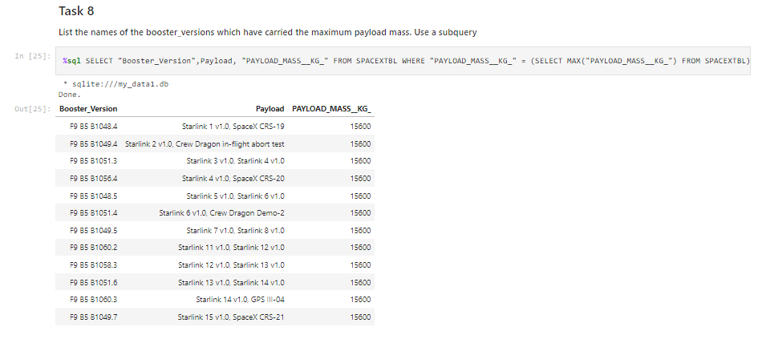
Boosters Carried Maximum Payload
List the names of the booster which have carried the maximum payload mass
Using a Subquery to return and pass the Max payload and used it list all the boosters that have carried the Max payload of 15600kgs

Slide 36
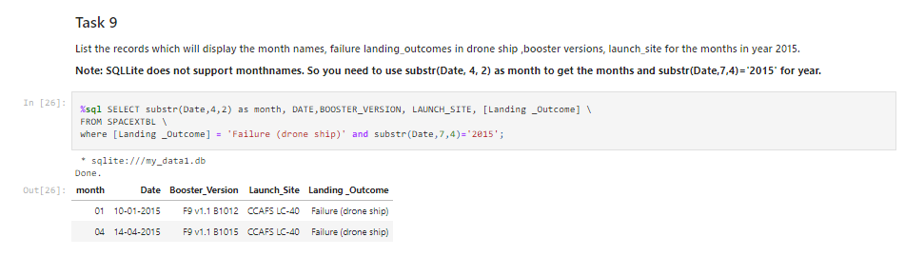
2015 Launch Records
List the failed landing_outcomes in drone ship, their booster versions, and launch site names for in year 2015
Used the ‘subsrt()’ in the select statement to get the month and year from the date column where substr(Date,7,4)='2015' for year and Landing_outcome was ‘Failure (drone ship’) and return the records unmatching the filter.

Slide 37
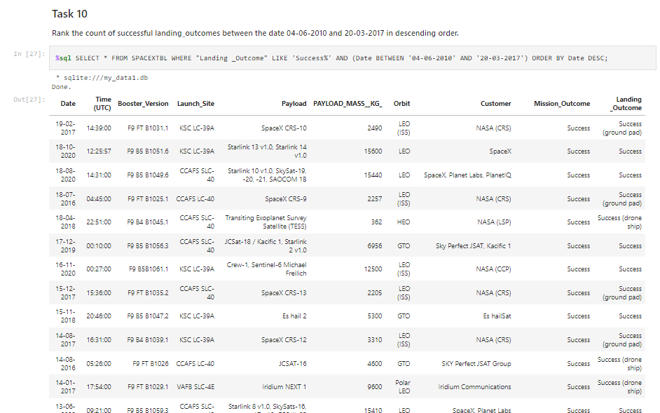
Rank Landing Outcomes Between 2010-06-04 and 2017-03-20
Rank the count of landing outcomes (such as Failure (drone ship) or Success (ground pad)) between the date 2010-06-04 and 2017-03-20, in descending order

Slide 38

Section 3

Slide 39
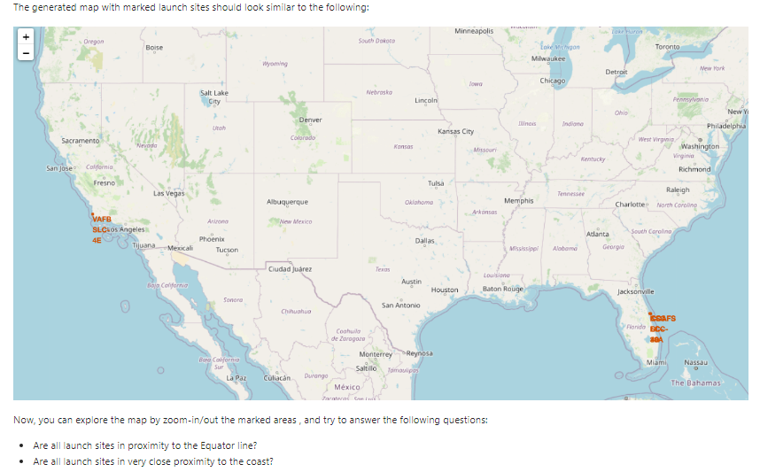
Markers of all launch sites on global map
All launch sites are in proximity to the Equator, (located southwards of the US map). Also all the launch sites are in very close proximity to the coast.

Slide 40
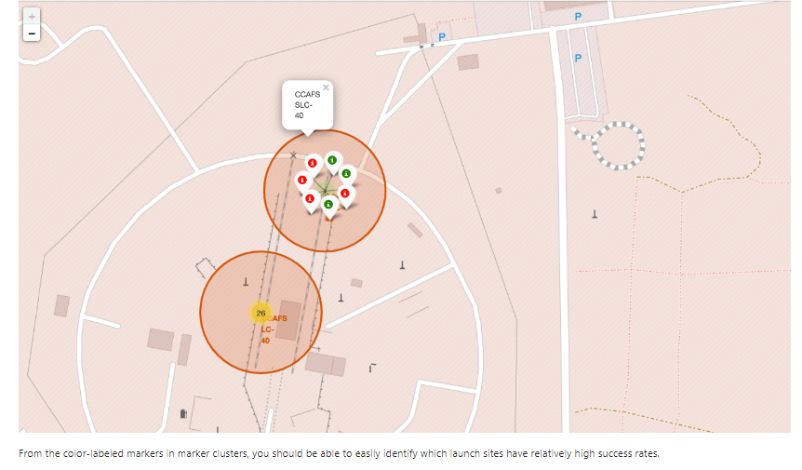
Mark the success/failed launches for each site on the map

Slide 41
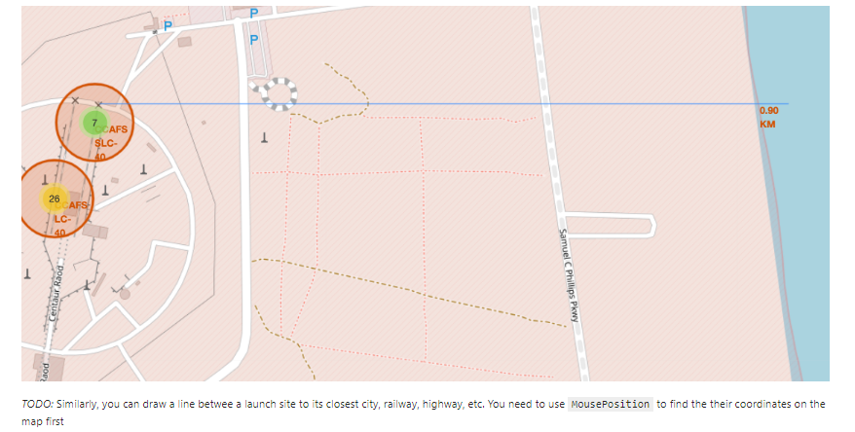
Distances between a launch site to its proximities
Launch site CCAFS SLC-40 proximity to coastline is 0.90km

Slide 42

Section 4

Slide 43
Pie-Chart for launch success count for all sites
Launch site KSC LC-39A has the highest launch success rate at 42% followed by CCAFS LC-40 at 29%, VAFB SLC-4E at 17% and lastly launch site CCAFS SLC-40 with a success rate of 13%

Slide 44
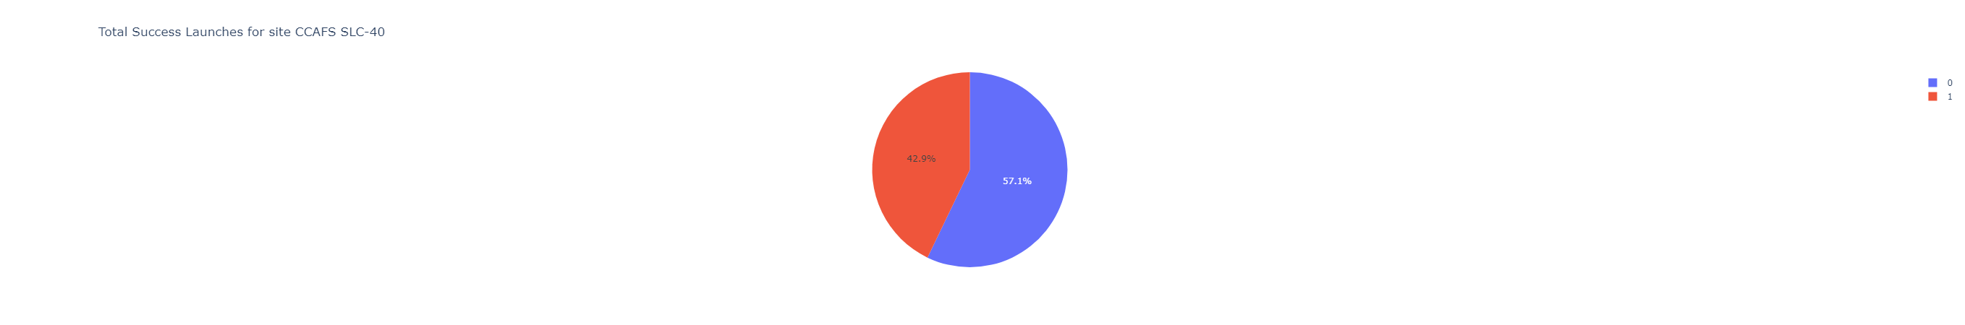
Pie chart for the launch site with least launch success ratio
Launch site CCAFS SLC-40 had the 2nd highest success ratio of 57% success against 43% failed launches

Slide 45
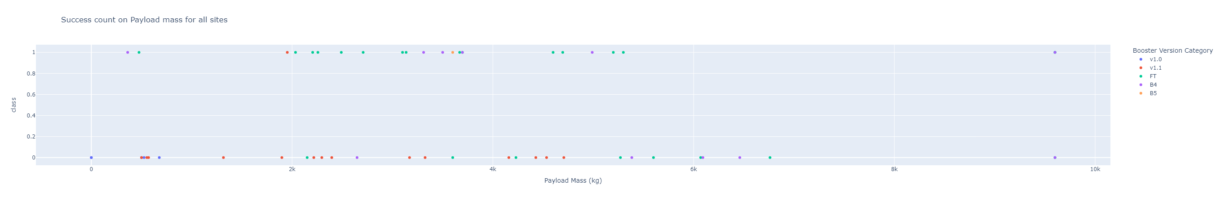
Payload vs. Launch Outcome scatter plot for all sites

Slide 46

Section 5

Slide 47
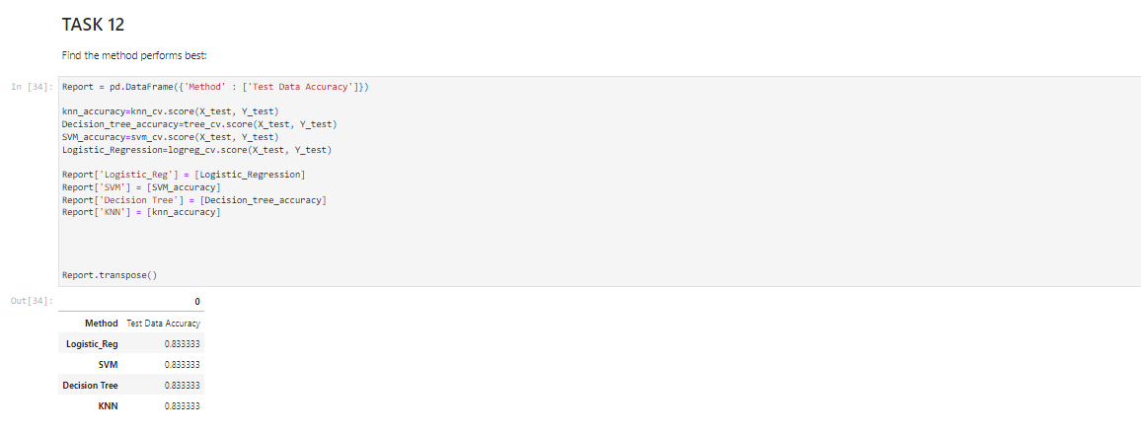
Classification Model Accuracy
All the methods perform equally on the test data

Slide 48
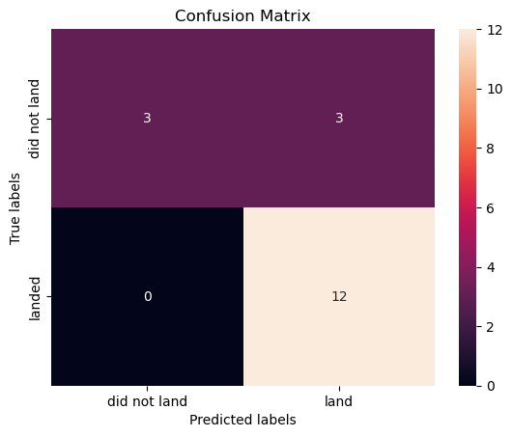
Confusion Matrix
All the 4 classification model had the same confusion matrixes and were able equally distinguish between the different classes. The major problem is false positives for all the models.

Slide 49
Conclusions
• Different launch sites have different success rates. CCAFS LC-40, has a success rate of 60 %, while KSC LC-39A and VAFB SLC 4E has a success rate of 77%.
• We can deduce that, as the flight number increases in each of the 3 launch sites, so does the success rate. For instance, the success rate for the VAFB SLC 4E launch site is 100% after the Flight number 50. Both KSC LC 39A and CCAFS SLC 40 have a 100% success rates after 80th flight
• If you observe Payload Vs. Launch Site scatter point chart you will find for the VAFB-SLC launchsite there are no rockets launched for heavypayload mass(greater than 10000).
• Orbits ES-L1, GEO, HEO & SSO have the highest success rates at 100%, with SO orbit having the lowest success rate at ~50%. Orbit SO has 0% success rate.
• LEO orbit the Success appears related to the number of flights; on the other hand, there seems to be no relationship between flight number when in GTO orbit
• And finally the success rate since 2013 kept increasing till 2020.

Slide 50


